Slide 1
Operating System [ 4th-Semester]

Slide 2
Process Scheduling

Slide 3
Introduction
An important aspect of multiprogramming is scheduling. The resources that are scheduled are IO and processors.
The goal is to achieve
High processor utilization
High throughput
number of processes completed per unit time
Low response time
time elapse from the submission of a request to the beginning of the response

Slide 4
Operating System - Process Scheduling
The process scheduling is the activity of the process manager that handles the removal of the running process from the CPU and the selection of another process on the basis of a particular strategy.
Process scheduling is an essential part of a Multiprogramming operating systems. Such operating systems allow more than one process to be loaded into the executable memory at a time and the loaded process shares the CPU using time multiplexing.

Slide 5
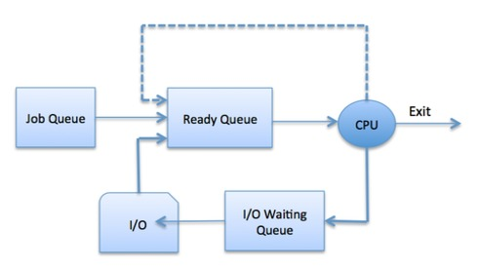
Process Scheduling Queues
Job queue: This queue keeps all the processes in the system.
Ready queue: This queue keeps a set of all processes residing in main memory, ready and waiting to execute. A new process is always put in this queue.
Device queues: The processes which are blocked due to unavailability of an I/O device constitute this queue.

Slide 6
Schedulers
Schedulers are special system software which handle process scheduling in various ways. Their main task is to select the jobs to be submitted into the system and to decide which process to run. Schedulers are of three types −
Long-Term Scheduler
Short-Term Scheduler
Medium-Term Scheduler
Long Term Scheduler: It is also called a job scheduler. A long-term scheduler determines which programs are admitted to the system for processing. It selects processes from the queue and loads them into memory for execution. Process loads into the memory for CPU scheduling.
Short Term Scheduler:It is also called as CPU scheduler. Its main objective is to increase system performance in accordance with the chosen set of criteria. It is the change of ready state to running state of the process. CPU scheduler selects a process among the processes that are ready to execute and allocates CPU to one of them.

Slide 7
Schedulers
Medium Term Scheduler: Medium-term scheduling is a part of swapping. It removes the processes from the memory. It reduces the degree of multiprogramming. The medium-term scheduler is in-charge of handling the swapped out-processes.
A running process may become suspended if it makes an I/O request. A suspended processes cannot make any progress towards completion. In this condition, to remove the process from memory and make space for other processes.
What is Dispatcher in OS
A dispatcher is a special program that comes into play after the scheduler. When the short term scheduler selects from the ready queue, the Dispatcher performs the task of allocating the selected process to the CPU. A running process goes to the waiting state for IO operation etc., and then the CPU is allocated to some other process. This switching of CPU from one process to the other is called context switching

Slide 8
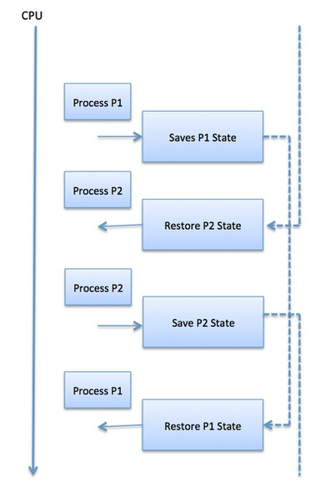
Context Switch
This switching of CPU from one process to the other is called context switching
A context switch is the mechanism to store and restore the state or context of a CPU in Process Control block so that a process execution can be resumed from the same point at a later time. Using this technique, a context switcher enables multiple processes to share a single CPU. Context switching is an essential part of a multitasking operating system features.

Slide 9
Concepts
Preemptive algorithm: Preemptive Scheduling is a scheduling method where the tasks are mostly assigned with their priorities. Sometimes it is important to run a task with a higher priority before another lower priority task, even if the lower priority task is still running
Non preemptive Algorithm:In this type of scheduling method, the CPU has been allocated to a specific process. The process that keeps the CPU busy will release the CPU either by switching context or terminating.

Slide 10
Categories of Scheduling Algorithms
Different environments need different scheduling algorithms
Batch
Still in wide use in business world
Non-preemptive algorithms reduces process switches
Interactive
Preemptive is necessary
Real time
Processes run quickly and block

Slide 11
Scheduling Criteria
CPU utilization – keep the CPU as busy as possible
Throughput – number of completed jobs per time unit
Completion Time: Time taken for the execution to complete, starting from arrival time.
Turn Around Time: Time taken to complete after arrival. In simple words, it is the difference between the Completion time and the Arrival time.
Turn Around Time = Completion Time - Arrival Time
Waiting Time: Total time the process has to wait before it's execution begins. It is the difference between the Turn Around time and the Burst time of the process.
Waiting Time = Turn around time - Burst Time
Response Ratio = (Waiting Time + Burst time) / Burst time
Burst Time=time required by a process for cpu execution

Slide 12
Scheduling in Batch Systems
First-come first-served
Shortest job first
Shortest Remaining Time Next

Slide 13
First-Come First-Serve(FCFS) Scheduling
Runnable process added to the end of ready queue
Non-preemptive
FCFS is very simple - Just a FIFO queue, like customers waiting in line at the bank or the post office or at a copying machine
Unfortunately, however, FCFS can yield some very long average wait times, particularly if the first process to get there takes a long time.

Slide 14


Example :1
Process CPU Burst Time
P1 24
P2 3
P3 3
In the first Gantt chart below, process P1 arrives first. Waiting time for P1 = 0; P2 = 24; P3 = 27
The average waiting time for the three processes is ( 0 + 24 + 27 ) / 3 = 17 ms.
Suppose that the processes arrive in the order P2 , P3 , P1 ,Waiting time for P1 = 6; P2 = 0; P3 = 3,In the second Gantt chart below, the same three processes have an average wait time of ( 0 + 3 + 6 ) / 3 = 3 ms.

Slide 15
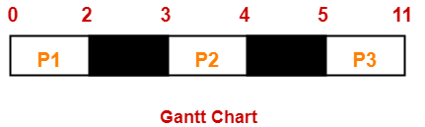
Example :2
Gantt Chart: Here, black box represents the idle time of CPU.
Turn Around time = Exit time/Completion time – Arrival time
Waiting time = Turn Around time – Burst time/Execution time
Process Id | Arrival time | Burst time
P1 | 0 | 2
P2 | 3 | 1
P3 | 5 | 6

Slide 16
Process Id | Exit time | Turn Around time | Waiting time
P1 | 2 | 2 – 0 = 2 | 2 – 2 = 0
P2 | 4 | 4 – 3 = 1 | 1 – 1 = 0
P3 | 11 | 11- 5 = 6 | 6 – 6 = 0
Now,
Average Turn Around time = (2 + 1 + 6) / 3 = 9 / 3 = 3 unit
Average waiting time = (0 + 0 + 0) / 3 = 0 / 3 = 0 unit

Slide 17

Shortest-Job-First Scheduling (SJF)
Shortest Job First (SJF) is an algorithm in which the process having the smallest execution time is chosen for the next execution.
Shortest job next (SJN), also known as shortest job first (SJF) or shortest process next (SPN), is a scheduling policy that selects for execution the waiting process with the smallest execution time.
Non-Preemptive SJF
Shortest next CPU burst first
The shortest process is execution first.
Example :1
Process CPU burst time
P1 6
P2 8
P3 7
P4 3
Average waiting time= (0+3+9+16)/4 = 7

Slide 18

Example :2
Completion time: p1=9,p2=11,p3=23,p4=3, p5=15
Turn Around Time = (Completion Time - Arrival Time)
P1=9-2=7,p2=11-5=6,p3=23-1=22,p4=3-0=3,p5=15-4=11
Average Turn around time =7+6+22+3+11/5=49/5
Waiting Time = (Turn around time - Burst Time )
P4= 3-3=0 P1= 7-6=1 P2= 6-2=4 P5= 11-4=7 P3= 22-8=14
Average Waiting Time= 0+1+4+7+14/5 = 26/5 = 5.2
Process | Burst time | Arrival time
P1 | 6 | 2
P2 | 2 | 5
P3 | 8 | 1
P4 | 3 | 0
P5 | 4 | 4

Slide 19

Shortest remaining time next
A preemptive version of shortest job first is shortest remaining time next.
A process with shortest burst time begins execution.
If a process with even a shorter burst time arrives, the current process is removed or preempted from execution, and the shorter job is allocated CPU cycle.
Example :1
Process CPU Burst Time Arrival Time
P1 8 0
P2 4 1
P3 9 2
P4 5 3
Average Waiting Time = ((10-1) +(1-1) + (17-2) +(5-3))/4 = 26/4= 6.5 ms

Slide 20
Scheduling in Interactive Systems
Round-Robin Scheduling
Priority Scheduling
Multiple Queues
Shortest Process Next
Guaranteed Scheduling
Fair-Share Scheduling
Lottery Scheduling

Slide 21
Round-Robin Scheduling
One of the Most widely used, oldest, fairest, and easiest algorithms is round robin.
Round robin is a preemptive algorithm
The CPU is shifted to the next process after fixed interval time, which is called time quantum/time slice.
Process runs until it blocks or time quantum exceeded
If the process has blocked or finished before the quantum has elapsed, the CPU switching is done when the process blocks, of course.

Slide 22

Example :1
Process Burst time
P1 24
P2 3
P3 3
Time Slice=4.
Ready Queue: P1,P2,P3,P1
The Gantt chart assuming all processes arrive at time 0 is:
Average Waiting Time={(10-4)+(4-0)+(7-0)}/3=17/3=5.66 ms.

Slide 23
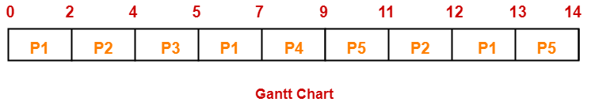
Example : 2 If the CPU scheduling policy is Round Robin with time quantum = 2 unit, calculate the average waiting time and average turn around time.
Process | Arrival time | Burst time
P1 | 0 | 5
P2 | 1 | 3
P3 | 2 | 1
P4 | 3 | 2
P5 | 4 | 3
Ready Queue: P1, P2,P3,P1, P4,P5,P2, P1, P5

Slide 24
Process | Turn Around time | Waiting time
P1 | 13 – 0 = 13 | 13 – 5 = 8
P2 | 12 – 1 = 11 | 11 – 3 = 8
P3 | 5 – 2 = 3 | 3 – 1 = 2
P4 | 9 – 3 = 6 | 6 – 2 = 4
P5 | 14 – 4 = 10 | 10 – 3 = 7
Now,
Average Turn Around time = (13 + 11 + 3 + 6 + 10) / 5 = 43 / 5 = 8.6 unit
Average waiting time = (8 + 8 + 2 + 4 + 7) / 5 = 29 / 5 = 5.8 unit

Slide 25
Priority Scheduling
Jobs are run based on their priority, Always run the job with the highest priority
Priorities can be externally defined (e.g., by user) or based on some process-specific metrics (e.g., their expected CPU burst)
Can be preemptive
Can be no preemptive
Priorities can be static (i.e. they don’t change) or dynamic (they may change during execution)
Problem =Starvation – low priority processes may never execute
Solution = Aging – as time progresses increase the priority of the process

Slide 26

Example 1. If the CPU scheduling policy is priority non-preemptive, calculate the average waiting time and average turn around time. (lower number represents higher priority)
Process Burst Time (ms) Priority
P1 10 3
P2 1 1
P3 2 4
P4 1 5
P5 5 2
Priority scheduling Gantt Chart assuming all arrive at time 0
Turn Around time = Exit time – Arrival time
Average waiting time = (0+1+6+16+18)/5 = 8.2 msec

Slide 27
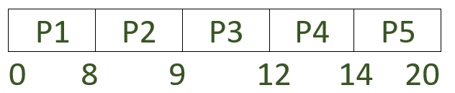
Example 2.
PROCESS | ARRIVAL TIME | BURST TIME | PRIORITY
P1 | 0 | 8 | 3
P2 | 1 | 1 | 1
P3 | 2 | 3 | 2
P4 | 3 | 2 | 3
P5 | 4 | 6 | 4
Priority Non-preemptive scheduling :
Average waiting time (AWT)= ((0-0) + (8-1) + (9-2) + (12-3) + (14-4)) / 5 = 33 / 5
= 6.6
Average turnaround time (TAT)= ((8-0) + (9-1) + (12-2) + (14-3) + (20-4)) / 5= 53 / 5
= 10.6

Slide 28
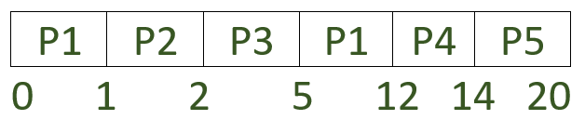
Priority Preemptive scheduling :
Average waiting time (AWT)= ((5-1) + (1-1) + (2-2) + (12-3) + (14-4)) / 5
= 23/5
= 4.6
Average turnaround time (TAT)= ((12-0) + (2-1) + (5-2) + (14-3) + (20-4)) / 5
= 43 / 5
= 8.5

Slide 29
Multi-level queue
A multi-level queue scheduling algorithm partitions the ready queue into several separate queues.
The processes are permanently assigned to one queue, generally based on some property of the process, such as memory size, process priority, or process type
For Example:
Separate queues might be used for foreground and background processes.
The foreground queue might be scheduled by Round Robin algorithm, while the background queue is scheduled by an FCFS algorithm.

Slide 30
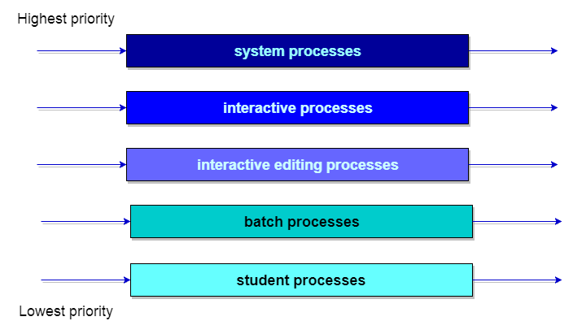
Let us consider an example of a multilevel queue-scheduling algorithm with five queues:
System Processes
Interactive Processes
Interactive Editing Processes
Batch Processes
Student Processes

Slide 31
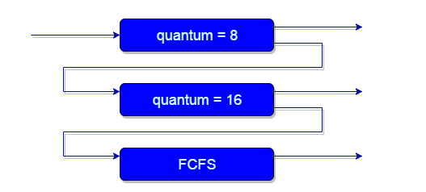
Multilevel Feedback Queue
Multilevel feedback queue scheduling, allows a process to move between queues.
The idea is to separate processes with different CPU-burst characteristics.
If a process uses too much CPU time, it will be moved to a lower-priority queue.
Similarly, a process that waits too long in a lower-priority queue may be moved to a higher-priority queue.

Slide 32
Multilevel feedback queue scheduler is defined by the following parameters:
The number of queues.
The scheduling algorithm for each queue.
The method used to determine when to upgrade a process to a higher-priority queue.
The method used to determine when to demote a process to a lower-priority queue.
The method used to determine which queue a process will enter when that process needs service.

Slide 33
Guaranteed Scheduling
Make real promises to the users about performance.
If there are n users logged in while you are working, you will receive about 1 /n of the CPU power.
Similarly, on a single-user system with n processes running, all things being equal, each one should get 1 /n of the CPU cycles.
To make good on this promise, the system must keep track of how much CPU each process has had since its creation.
CPU Time entitled= (Time Since Creation)/n
Then compute the ratio of Actual CPU time consumed to the CPU time entitled.

Slide 34
A ratio of 0.5 means that a process has only had half of what it should have had, and a ratio of 2.0 means that a process has had twice as much as it was entitled to.
The algorithm is then to run the process with the lowest ratio until its ratio has moved above its closest competitor.

Slide 35
Fair-Share Scheduling
• Users are assigned some fraction of the CPU
Scheduler takes into account who owns a process before scheduling it
This algorithm equally distributes the processor time to its users, for instance, there are 5 users (A, B, C, D, E)each of them are simultaneously executing a process, the scheduler divides the CPU periods such that all the users get the same share of the CPU cycles (100%/5) that is 20%. Even though, a user moves onto the second while the other at the first, the algorithm is so specific that it ensures that this user is attributed with only 10% for the second process making it a total of 20%.

Slide 36
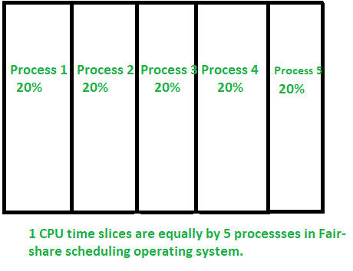
Fair-Share Scheduling

Slide 37
Lottery Scheduling [Waldspurger and Weihl 1994]
Jobs receive lottery tickets for various resources
E.g., CPU time
• At each scheduling decision, one ticket is chosen at random and the job holding that ticket wins
If there are 100 tickets outstanding, and one process holds 20 of them, it will have a 20% chance of winning each lottery. In the long run, it will get about 20% of the CPU.
Lottery scheduling can be used to solve problems that are difficult to handle with other methods.

Slide 38
Scheduling in Real-Time Systems
A real-time scheduling System is composed of the scheduler, clock and the processing hardware elements.
In a real-time system, a process or task has Schedulability ; tasks are accepted by a real-time system and completed as specified by the task deadline depending on the characteristic of the scheduling algorithm.
Real-time systems are generally categorized as hard real time, meaning there are absolute deadlines that must be met—or — and soft real time, meaning that missing an occasional deadline is tolerable.
The events that a real-time system may have to respond to can be further categorized as periodic (meaning they occur at regular intervals) or aperiodic (meaning they occur unpredictably).

Slide 39
Highest Response Ratio (HRN) Scheduling
HRRN(Highest Response Ratio Next )Scheduling is a non-preemptive scheduling algorithm in the operating system. It is one of the optimal algorithms used for scheduling.
As HRRN is a non-preemptive scheduling algorithm so in case if there is any process that is currently in execution with the CPU and during its execution, if any new process arrives in the memory with burst time smaller than the currently running process then at that time the currently running process will not be put in the ready queue & complete its execution without any interruption.
HRN is basically the modification of Shortest Job Next(SJN) in order to reduce the problem of starvation.
In the HRRN scheduling algorithm, the CPU is assigned to the next process that has the highest response ratio and not to the process having less burst time.
Response Ratio = (W+S)/S
Where,
W=It indicates the Waiting Time.
S=It indicates the Service time that is Burst Time.

Slide 40
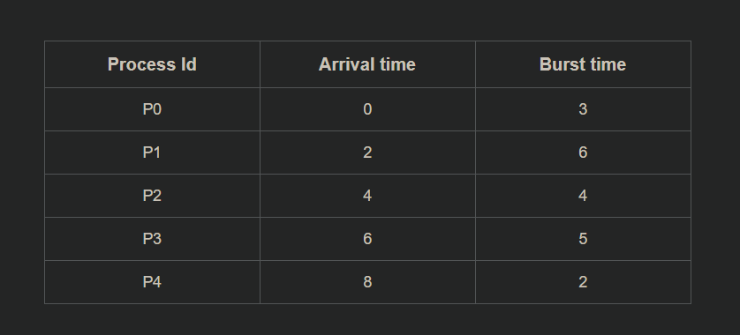

Slide 41
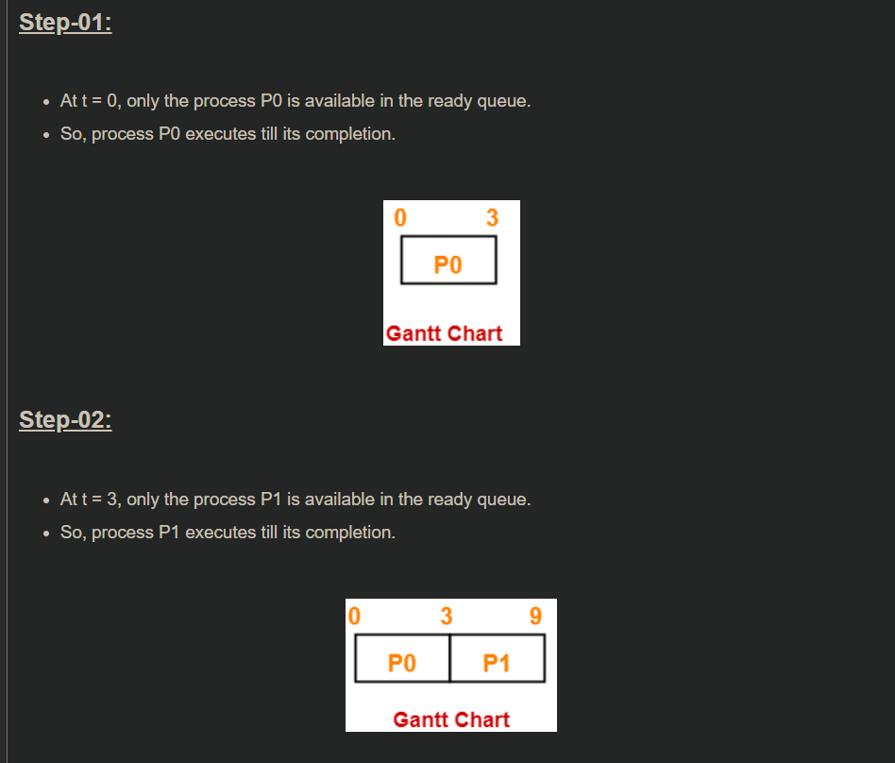
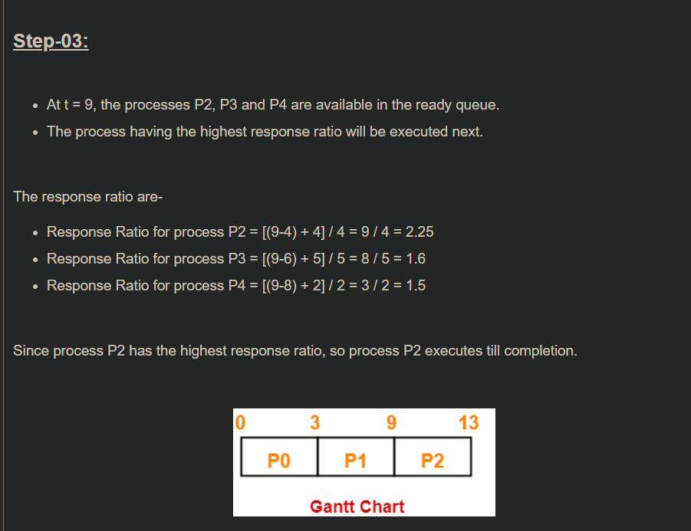

Slide 42
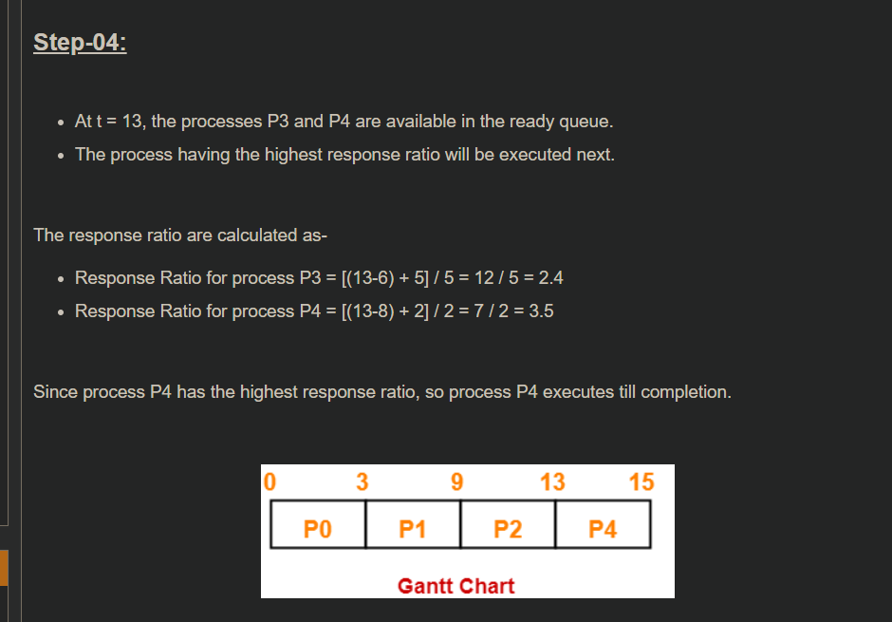
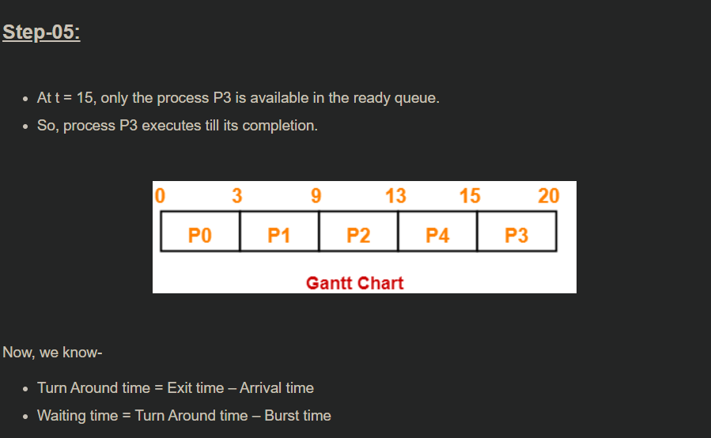

Slide 43
